Slide 1


The 5th UK Ontology Network Meeting,
April 14th 2016
Probabilistic Annotation Framework: Knowledge Assembly at Scale with Semantic and Probabilistic Techniques
Szymon Klarman¹, Larisa Soldatova¹, Robert Stevens² and Ross King²
¹Brunel University, London
²the University of Manchester

Slide 2
The Big Mechanism
www.darpa.mil/program/big-mechanism
$45 million DARPA research program.
2014 -2017.
Aims to develop software that will read cancer research papers, integrate them into a (big) cancer model, and frame new hypotheses.
We are in the Chicago Consortium (the University of Chicago, ISI (Information Sciences Institute, CA), Microsoft, the University of Manchester, Brunel University, London)

Slide 3
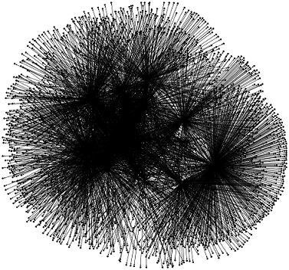


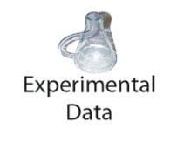
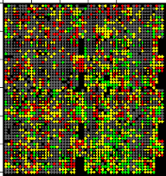
Reading-Assembly-Explanation
Reading
Assembly
Explanation
Very large conflicting
(probabilistic) network
Computational
hypotheses/
wet lab
Experiments
controlling
states of the
network
Smaller
(relevant)
grounded
model

Slide 4
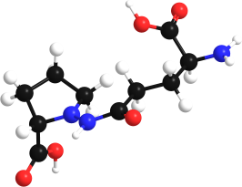


Knowledge assembly in Big Mechanism
Evidence contradicts
the model to degree 0.7
probabilistic inference
model updates
extraction
evidence
(probabilistic)
event knowledge
assembly
experimental
verification
learning
„GRB2 binding GAB1”
is true in PCM123456
„GRB2 binding GAB1”
is supported to degree 0.7
„GRB2 binding GAB1” is
experimentally confirmed

Slide 5
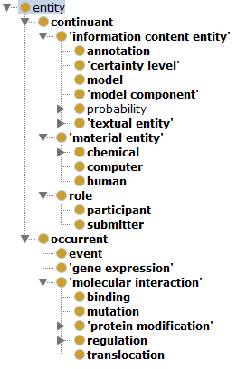
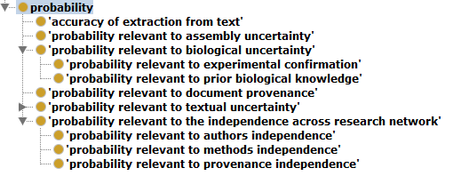
PAF: Probabilistic Annotation Framework
OWL ontology covering: event-related concepts, metadata concepts and probability types.

Slide 6
GRB2_MOUSE
rdf:type
Protein
rdf:type
GAB1_MOUSE
hasParticipantA
hasParticipantB
Binding
rdf:type
GRB2 binding GAB1
rdf:type
Event
0.7
represents
represents
0.6
0.8
0.7
hasProvenanceProb
hasProvenanceProb
hasExtractionProb
hasExtractionProb
statement_1
rdf:type
Statement
rdf:type
statement_..99
hasTruthValue
extractedFrom
extractedFrom
hasTruthValue
True
hasEvidence
PMC123456
PMC654321
hasEvidence
False
hasSubmitter
rdf:type
rdf:type
hasSubmitter
„In addition, GRB2 can associate with GAB1”
„GRB2 does not interact directly with GAB1”
Article
NaCTeM
rdf:type
Submitter
rdf:type
FRIES

Slide 7
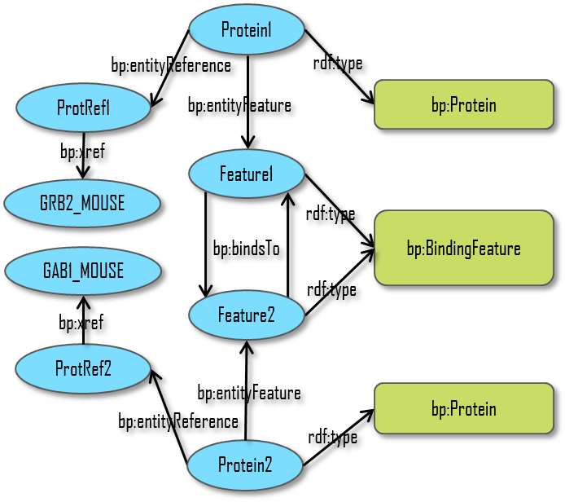
GRB2_MOUSE
rdf:type
Protein
rdf:type
GAB1_MOUSE
hasParticipantA
hasParticipantB
Binding
rdf:type
GRB2 binding GAB1
rdf:type
Event
Existing BioPax model:
What is the relation of the extracted infromation to the model:
corroboration
conflict
specification

Slide 8
Probabilistic inference in model assembly
https://dtai.cs.kuleuven.be/problog/editor.html#hash=d25614ef1b8f019b5834b0361ef07a4a
event(ev).
0.7::supported(X) :- event(X),
statement(Y),
represents(Y, X),
hasTruthValue(Y, true),
combinedProb(Y).
combinedProb(Y) :- extractionProb(Y),
provenanceProb(Y).
support for an event
= disjoint sum of (combined) probabilities of
different supporting statements,
with each statement weighted by 0.7
combined probability = product of all probability scores
statement(s1).
represents(s1, ev).
hasTruthValue(s1, true).
0.8::extractionProb(s1).
0.7::provenanceProb(s1).
statement(s2).
represents(s2, ev).
hasTruthValue(s2, true).
0.7::extractionProb(s2).
0.6:: provenance Prob(s2).
Note the increase in the probability of corroborated(ev)
on adding the second supporting statement
supported(ev) → 0.392
supported(ev) → 0.570752

Slide 9
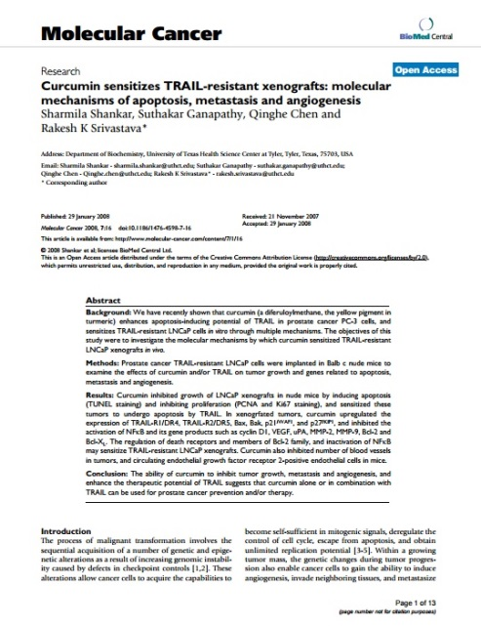
Extracting events with uncertainty scores
In vitro curcumin downregulated the expression of Bcl-2, and Bcl-XL and upregulated the expression of p53, Bax, Bak, PUMA, Noxa, and Bim at mRNA and protein levels in prostate cancer cells [14].
Treatment of mice with curcumin enhanced the expression of Bax, Bak, DR4 and DR5, and inhibited the expression of antiapoptotic Bcl-2 and Bcl-XL proteins.
PMC2249593
Event Id | Molecule | Interaction | Gene | Extraction Accuracy | Textual Uncertainty | Provenance Uncertainty
E32462 | curcumin | negative regulation | BCL2_MOUSE | 0.678 | certain | 0.475
E32744 | curcumin | positive regulation | P53_HUMAN | 0.658 | certain | 0.475
... | ... | ... | ... | ... | ... | ...

Slide 10
Computing Total Uncertainty
Extraction Accuracy
Textual Uncertainty
Provenance Uncertainty
ExperimentalConfirmation
T | F | -
0.9 | 0.1 | 0.5
Total Uncertainty
Event Id | Molecule | Interaction | Gene | Total Uncertainty Before Experiment | Experimental Confirmation | Total Uncertainty After Experiment
E32462 | curcumin | negative regulation | BCL2_MOUSE | 0.3941 | TRUE | 0.7489
E32744 | curcumin | positive regulation | P53_HUMAN | 0.3924 | FALSE | 0.1569
E32549 | curcumin | negative regulation | Q9H014_HUMAN | 0.3929 | - | 0.3929
... | ... | ... | ... | ... | ... | ...

Slide 11
Updating the Model
  The current model is checked against the extracted events
  For example, it does not have a link
curcumin – negative regulation - protein Q9H014_HUMAN.
  Therefore the model can be extended by adding the link with a moderately high certainty

Slide 12
Thank you

