Slide 1



The Synthetic Biology Open Language (SBOL)
14 April 2016
UK Ontology Network
Goksel Misirli, James McLaughlin, Matthew Pocock, Anil Wipat
Interdisciplinary Computing and Complex BioSystems (ICOS) research group
School of Computing Science

Slide 2





Synthetic Biology
Scientific Literature
Biological Databases
Design Tools
Design
Build
Test
Engineering novel and predictable biological systems
  Biosensing
  Bioremediation
  Production of useful compounds
Through existing engineering paradigms
  Standardisation
  Modularity
  Abstraction
GFP
pSpaS
RBS
gfp
terminator

Slide 3
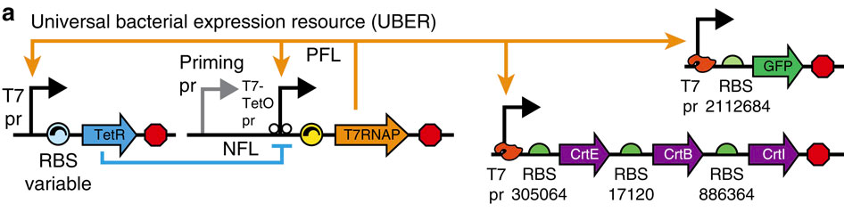
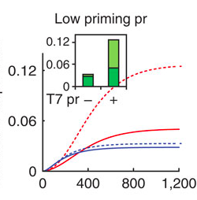
Biological system design Information
DNA sequence information
Regulatory elements
Molecular interactions
Their order and layout
Predictive models
Experimental conditions and results
Chassis information
Supporting materials, raw data
Design specific information
  Regulatory issues
Kushwaha and Salis, 2015

Slide 4
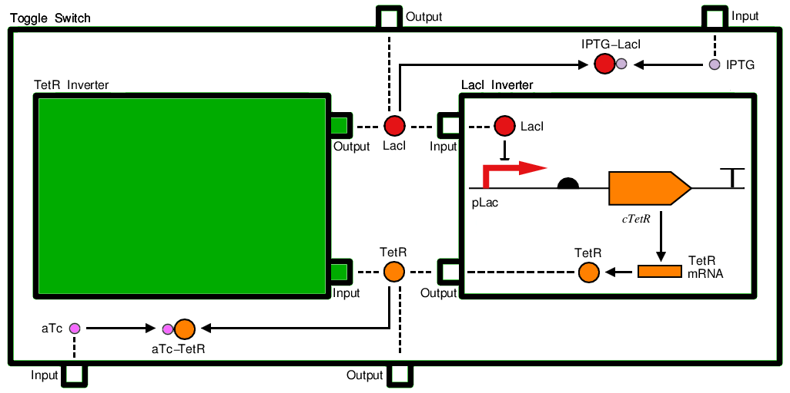
SBOL 2.0
Generic
TopLevel
Sequence
Model
Collection
Component
Definition
Module Definition
Bartley, Beal, Clancy, Misirli, Roehner, et al., SBOL Version 2.0.0

Slide 5


A biological example
Subtilin Sensor
Receiver
Reporter
SpaK*
GFP
Subtilin
SpaR
SpaK
Output
Input
TF
SpaR*
pSpaS
RBS
gfp
terminator
pSpaRK
RBS
spaK
RBS
spaR
terminator
- SBML
- Discrete
- Kappa
- Rule-based

Slide 6
SBOL utilises existing Semantic Web resources
BioPAX
Sequence Ontology
Systems Biology Ontology
EDAM Ontology
Standard sequence encodings
Provenance Ontology
Dublin Core Metatada Initiative Terms
uri= partsRegistry:BBa_J23119
name= “J23119 promoter”
description= “Constitutive promoter”
type= biopax:DnaRegion
role=so:Promoter
uri= partsRegistry:BBa_J23119_sequence
elements= “ttgacagctagctcagtcctaggtataatgctagc”
encoding= IUPAC:DNA

Slide 7
Serialisation example
<?xml version="1.0" ?>
<rdf:RDF xmlns:rdf="http://www.w3.org/1999/02/22-rdf-syntax-ns#" xmlns:dcterms="http://purl.org/dc/terms/" xmlns:prov="http://www.
w3.org/ns/prov#" xmlns:sbol="http://sbols.org/v2#">
<sbol:ComponentDefinition rdf:about=http://partsregistry.org/cd/BBa_J23119>
<sbol:displayId>BBa_J23119</sbol:displayId>
  <dcterms:title>J23119 promoter</dcterms:title>
  <dcterms:description>Constitutive promoter</dcterms:description>
  <sbol:type rdf:resource="http://www.biopax.org/release/biopax-level3.owl#DnaRegion"/>
  <sbol:role rdf:resource="http://identifiers.org/so/SO:0000167"/>
  <sbol:sequence rdf:resource="http://partsregistry.org/seq/BBa_J23119"/>
</sbol:ComponentDefinition>
<sbol:Sequence rdf:about="http://partsregistry.org/seq/BBa_J23119">
  <sbol:displayId>BBa_J23119</sbol:displayId>
  <sbol:elements>ttgacagctagctcagtcctaggtataatgctagc</sbol:elements>
  <sbol:encoding rdf:resource="http://www.chem.qmul.ac.uk/iubmb/misc/naseq.html"/>
</sbol:Sequence>
</rdf:RDF>

Slide 8
Summary
Unambiguous exchange of synthetic biology designs
Facilitates the reuse of information
Extendible data model
Integrates well with the existing Semantic Web technologies to store, retrieve and query data

Slide 9


Thanks
http://sbolstandard.org

Slide 10
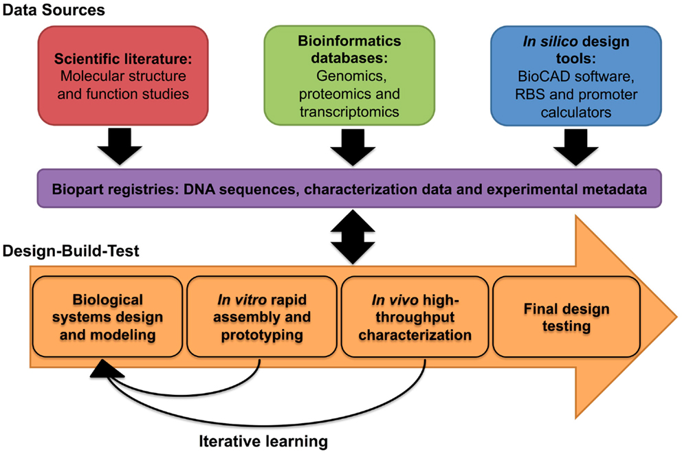
Interdisciplinary nature of synthetic biology
Kelwick et al., 2014

Slide 11
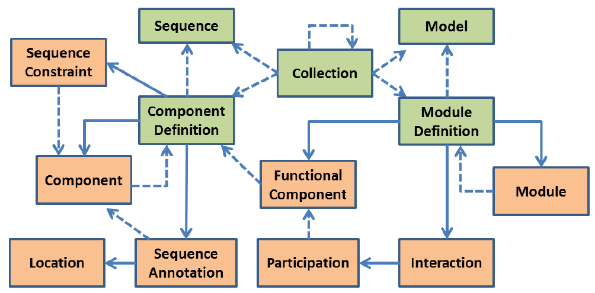
SBOL 2.0 – data model

