Slide 1




An ontology-supported approach to predict automatically the proteases involved in the generation of peptides
Mercedes Arguello Casteleiro¹, Julie Klein² and Robert Stevens¹
¹School of Computer Science, University of Manchester, Oxford road, Manchester, United Kingdom.
²Institut National de la Santé et de la Recherche Médicale (INSERM), U1048, Toulouse, France. And Université Toulouse III Paul-Sabatier, Toulouse, France.

Slide 2
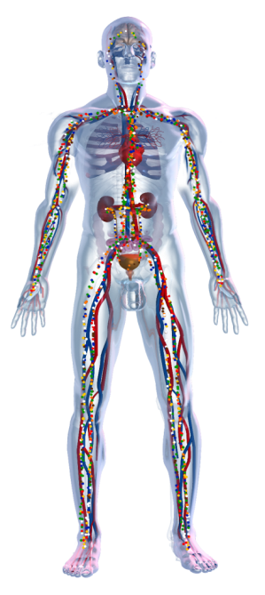
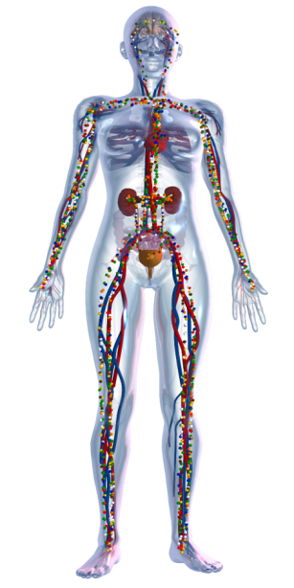
Biomedical Background
why omics?
Omics: studying “all” molecules collectively
Complex diseases cannot be adequately described by single features:
Interindividual differences
Mechanism multiplicity

Slide 3
Tools & Applications
Peptides represent a new source of very useful biomarkers in kidney and other disease.
Peptides can help better understanding the pathophysiological mechanisms:
  Parental proteins
  Proteases
Parent protein
Protease
Peptide

Slide 4

Tools & Applications
Peptides represent a new source of very useful biomarkers in kidney and other disease.
Peptides can help better understanding the pathophysiological mechanisms:
  Parental proteins
  Proteases
Initially:
Very tedious work!
HELP ?

Slide 5
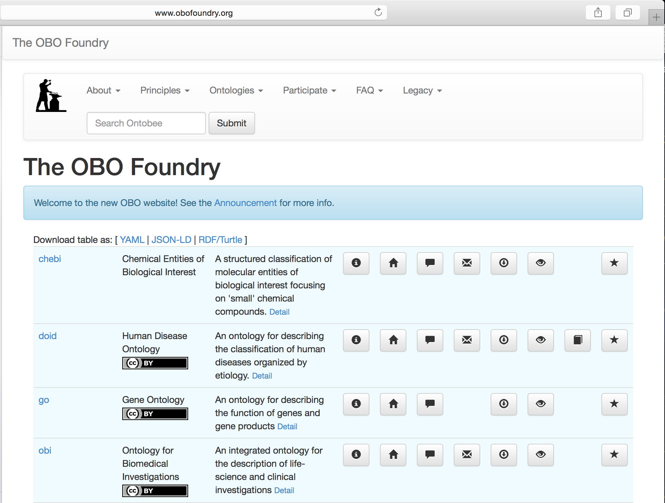
Proteasix Ontology (PxO) reuse ontologies

Slide 6
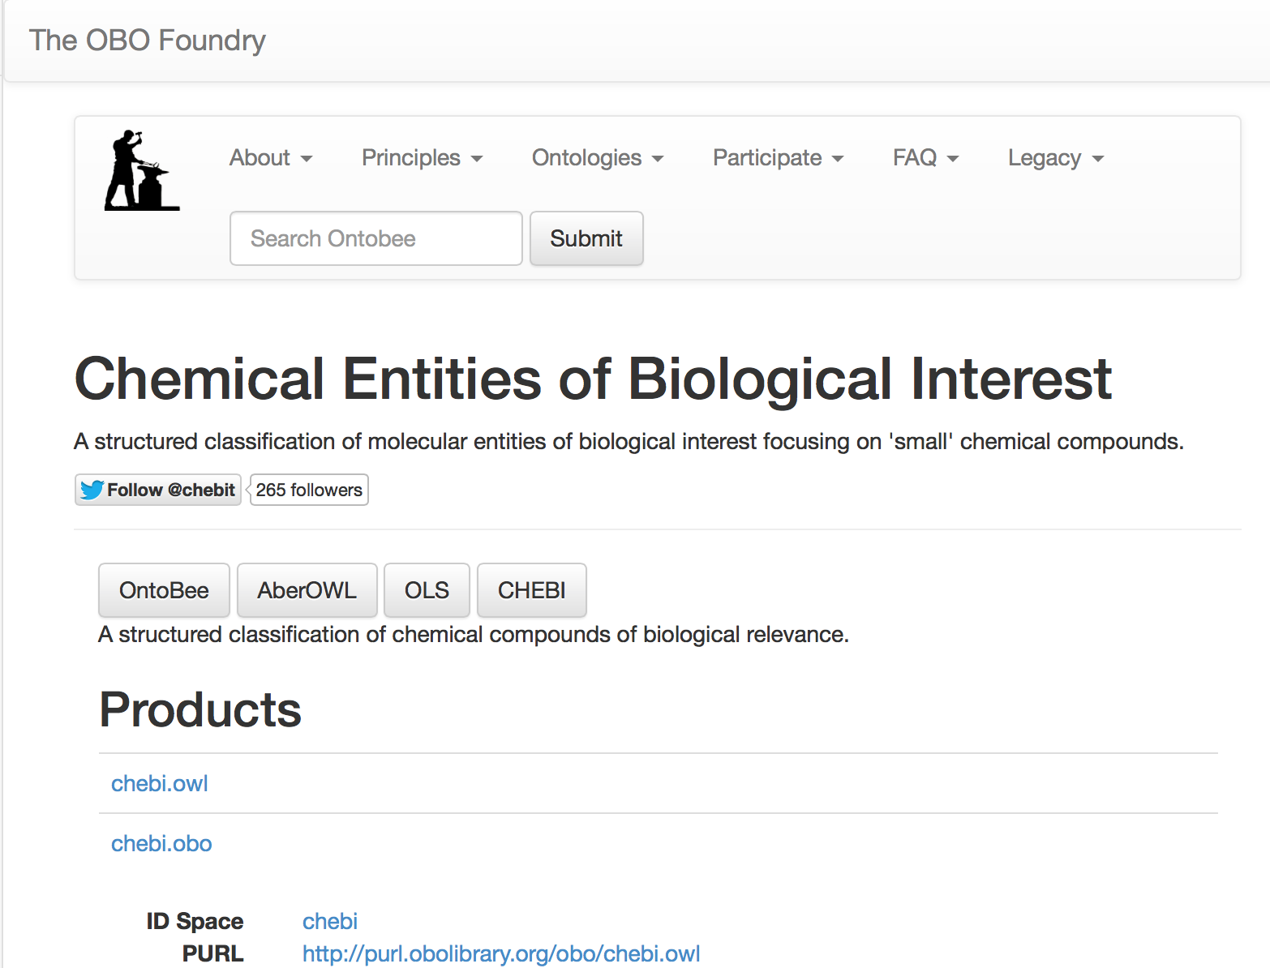
Proteasix Ontology (PxO) reuse ontologies
chemical entity
molecular entity
Alanine

Slide 7
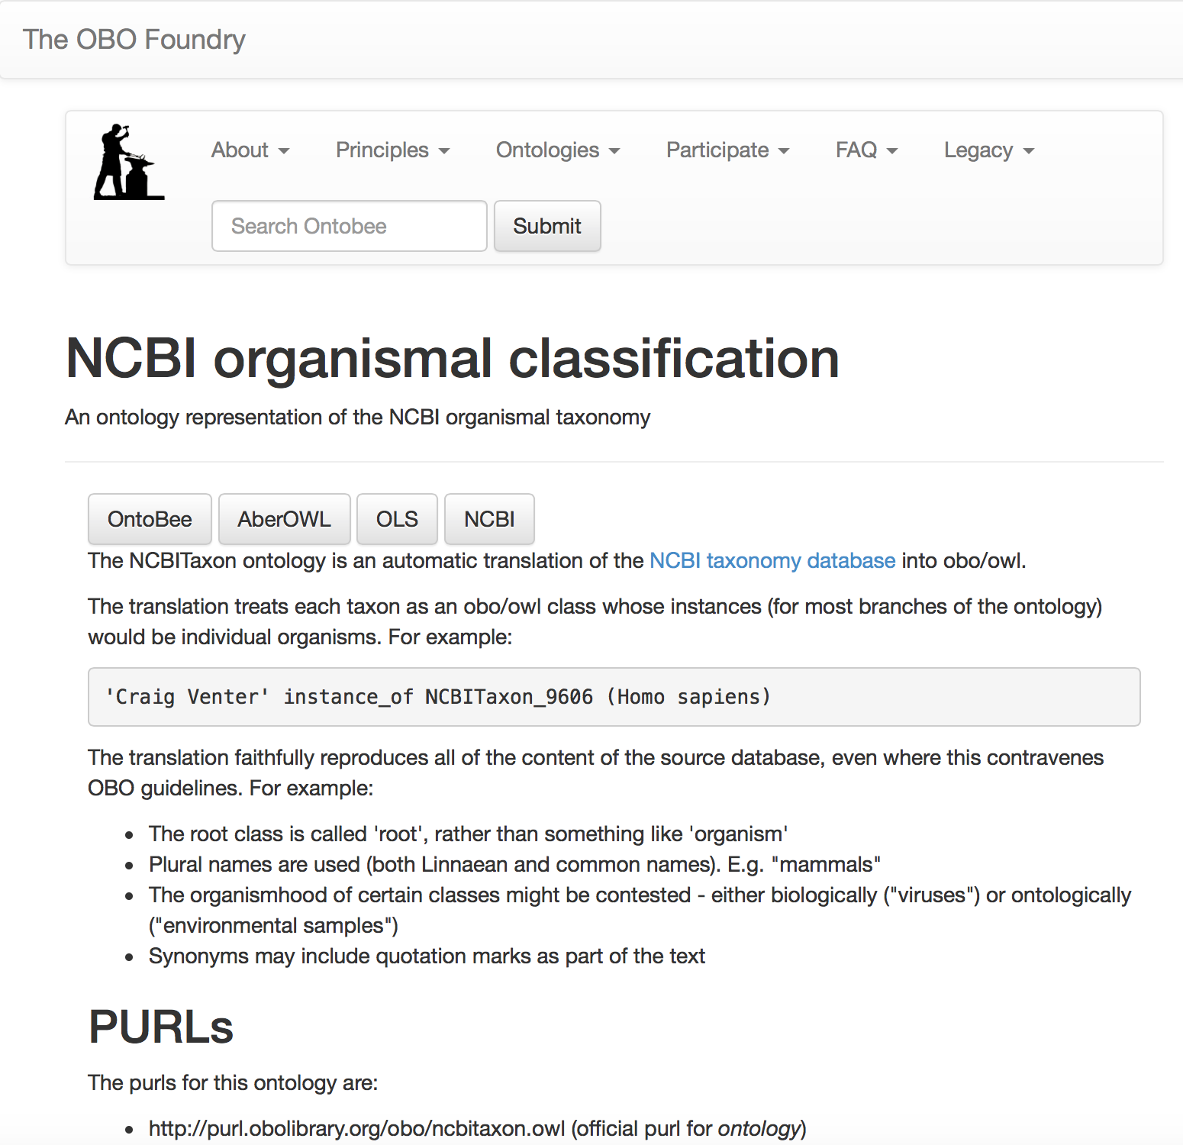
Proteasix Ontology (PxO) reuse ontologies
Human
Rat
Mouse

Slide 8
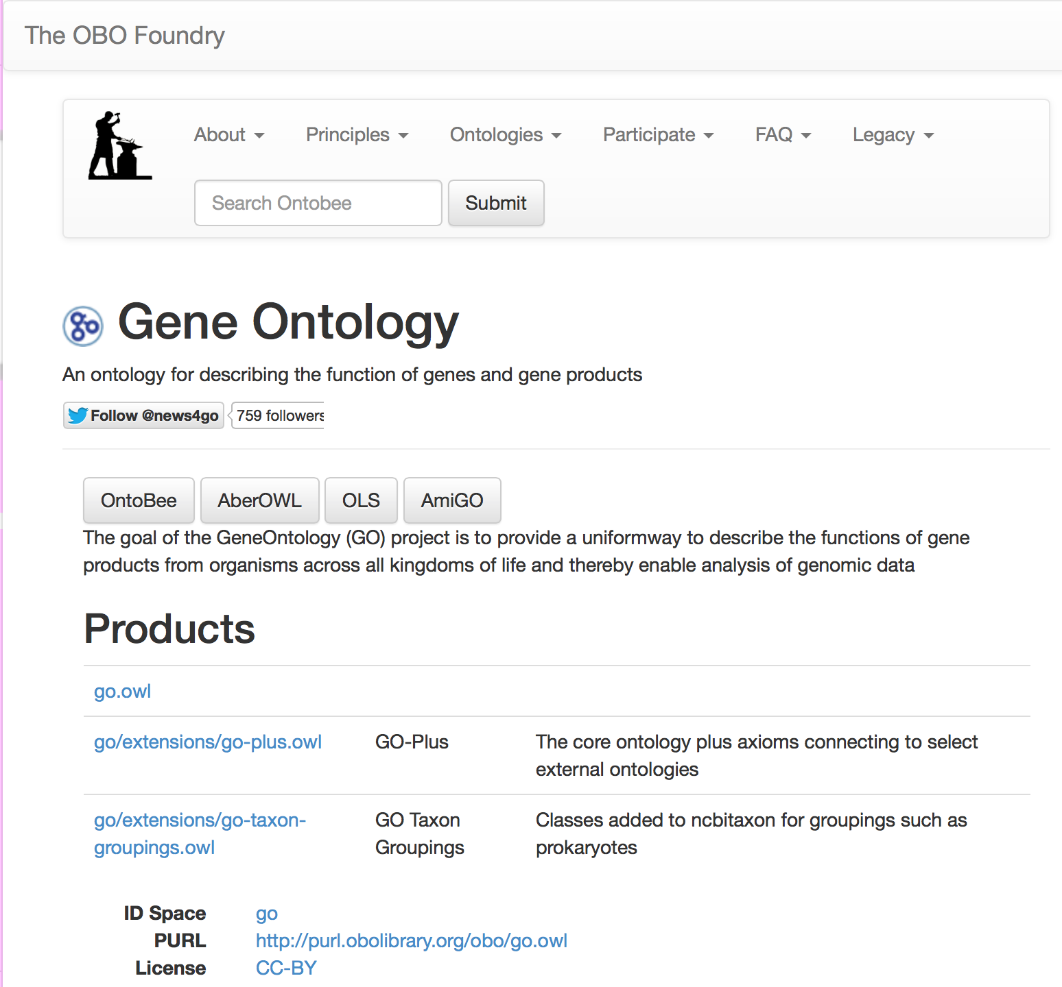
Proteasix Ontology (PxO) reuse ontologies
molecular_function
cellular_component
biological_process

Slide 9
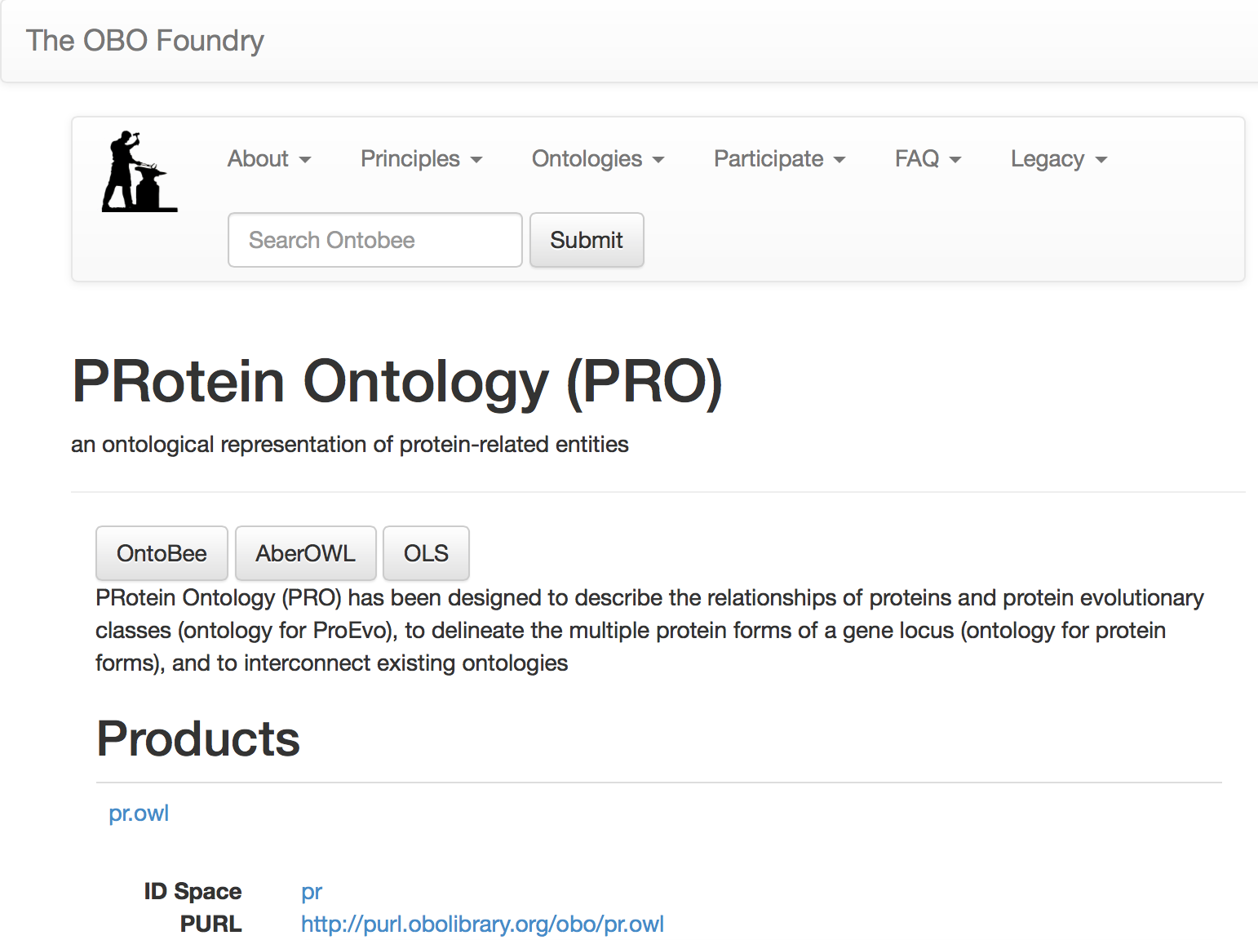
Proteasix Ontology (PxO) reuse ontologies
Protein
amino acid chain
proteolytic cleavage product

Slide 10
Current Work: Proteasix Ontology (PxO)
UniProt KB proteins (Swiss-prot and TrEMBL)
  Organised by Taxons following PRO ontology
  Annotated with GO biological_process; GO cellular_component; and GO molecular_function
Model cleavage sites patterns for
  Exopeptidase activity
  Endopeptidase activity

Slide 11
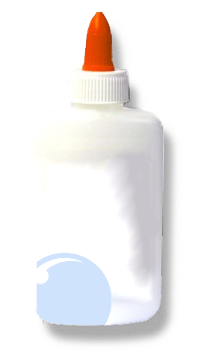

For using Peptides as Biomarkers, we need more data.. and data linkage..
OWL
(ontologies)
Let’s glue the relevant knowledge together
Class: polypeptide_region
SubClassOf:
biological_region
part_of some protein,
associated_with some 'proteolytic cleavage product',
only_in_taxon some organism

Slide 12
For using Peptides as Biomarkers, we need more data.. and data linkage..
In Swiss-Prot there are proteins annotated with GO:0004252, which is serine-type endopeptidase activity
SPARQL
(queries)
Let’s get them!
SELECT ?x FROM <file:./ontofiles/Swiss-Prot.owl>
{
?x rdf:type owl:Class;
rdfs:subClassOf [ a owl:Restriction ;
owl:onProperty pr:has_function ;
owl:someValuesFrom obo:GO_0004252 ] .
}

Slide 13
For using Peptides as Biomarkers, we need more data.. and data linkage..
Can we retrieve from Swiss-Prot ALL the proteins annotated with any DESCENDANT of Peptidase activity GO_0008233 ?
SPARQL
(queries)
Let’s get Pepetidase Activities from GO, e.g. serine-type endopeptidase activity GO:0004252
GRAPH <file:./ontofiles/ GO_TAXONOMY_molecular_function.owl> {?C rdfs:subClassOf+ obo:GO_0008233 . } .

Slide 14
For using Peptides as Biomarkers, we need
more data.. and data linkage..
Can we retrieve from Swiss-Prot ALL the proteins annotated with any DESCENDANT of Peptidase activity GO_0008233 ?
SPARQL
(queries)
YES! let’s get proteins annotated with Pepetidase Activities from GO
SELECT ?x FROM <file:./ontofiles/Swiss-Prot.owl)>
FROM NAMED <file:./ontofiles/GO_TAXONOMY_molecular_function.owl>
{
GRAPH <file:./ontofiles/GO_TAXONOMY_molecular_function.owl>
{?C rdfs:subClassOf+ obo:GO_0008233 . } .
{ ?x rdf:type owl:Class;
rdfs:subClassOf [ a owl:Restriction ;
owl:onProperty pr:has_function ;
owl:someValuesFrom ?C ] .
} }

Slide 15
Concluding remarks
TopFIND2 and Proteasix can help to automatically predict modification of protease activity
Current work: exploring the benefits of using Proteasix ontology (PxO) in the Semantic-Web version of Proteasix
Hard Limits:
  Prediction always need validation
  Data available (over-representation of some proteases, other are missing)

Slide 16


ACKNOWLEDGMENT: to Julie Klein for providing
Biomedical background
Comparison of Current Tools & Applications

